Slide 1
Human Resource Management
Chapter
12

Slide 2
L E A R N I N G O U T L I N E
Follow this Learning Outline as you read and study this chapter.
Why Human Resources Is Important:
The HRM Process
  Explain how an organization’s human resources can be a significant source of competitive advantage.
  List eight activities necessary for staffing the organization and sustaining high employee performance.
  Discuss the environmental factors that most directly affect the HRM process.

Slide 3
L E A R N I N G O U T L I N E (cont’d)
Follow this Learning Outline as you read and study this chapter.
Human Resource Planning; Recruitment/ Decruitment; Selection; Orientation; Training
  Contrast job analysis, job description, and job specification.
  Discuss the major sources of potential job candidates.
  Describe the different selection devices and which work best for different jobs.
  Tell what a realistic job preview is and why it’s important.
  Explain why orientation is so important.
  Describe the different types of training and how that training can be provided.

Slide 4
L E A R N I N G O U T L I N E (cont’d)
Follow this Learning Outline as you read and study this chapter.
Employee Performance Management; Compensation/Benefits; Career Development
  Describe the different performance appraisal methods.
  Discuss the factors that influence employee compensation and benefits.
  Describe skill-based and variable pay systems.
  Describe career development for today’s employees.
Current Issues in Human Resource Management
  Explain how managers can manage downsizing.
  Discuss how managers can manage workforce diversity.

Slide 5
L E A R N I N G O U T L I N E (cont’d)
Follow this Learning Outline as you read and study this chapter.
Current Issues in Human Resource Management (cont’d)
  Explain what sexual harassment is and what managers need to know about it.
  Describe how organizations are dealing with work-life balances.

Slide 6
The Importance of Human Resource Management (HRM)
As a necessary part of the organizing function of management
  Selecting, training, and evaluating the work force
As an important strategic tool
  HRM helps establish an organization’s sustainable competitive advantage.
Adds value to the firm
  High performance work practices lead to both high individual and high organizational performance.

Slide 7
Exhibit 12–1 Examples of High-Performance Work Practices
Self-managed teams
Decentralized decision making
Training programs to develop knowledge, skills, and abilities
Flexible job assignments
Open communication
Performance-based compensation
Staffing based on person–job and person–organization fit
Source: Based on W. R. Evans and W. D. Davis, “High-Performance Work Systems and Organizational Performance: The Mediating Role of Internal Social Structure,” Journal of Management, October 2005, p. 760.

Slide 8
The HRM Process
Functions of the HRM Process
  Ensuring that competent employees are identified and selected.
  Providing employees with up-to-date knowledge and skills to do their jobs.
  Ensuring that the organization retains competent and high-performing employees who are capable of high performance.

Slide 9
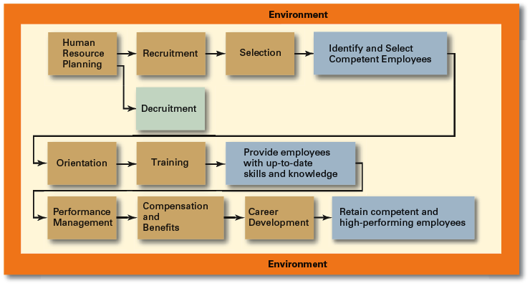
Exhibit 12–2 Human Resource Management Process

Slide 10
Environmental Factors Affecting HRM
Employee Labor Unions
  Organizations that represent workers and seek to protect their interests through collective bargaining.
    Collective bargaining agreement
      A contractual agreement between a firm and a union elected to represent a bargaining unit of employees of the firm in bargaining for wage, hours, and working conditions.
Governmental Laws and Regulations
  Limit managerial discretion in hiring, promoting, and discharging employees.
    Affirmative Action: the requirement that organizations take proactive steps to ensure the full participation of protected groups in its workforce.

Slide 11
Exhibit 12–3 Major U.S. Federal Laws and Regulations Related to HRM
1963 Equal Pay Act
1964 Civil Rights Act, Title VII (amended in 1972)
1967 Age Discrimination in Employment Act
1973 Vocational Rehabilitation Act
1974 Privacy Act
1978 Mandatory Retirement Act
1986 Immigration Reform and Control Act
1988 Worker Adjustment and Retraining Notification Act
1990 Americans with Disabilities Act
1991 Civil Rights Act of 1991
1993 Family and Medical Leave Act of 1993
1996 Health Insurance Portability and Accountability Act of 1996
2003 Fair and Accurate Credit Transactions Act
2004 FairPay Overtime Initiative

Slide 12
Managing Human Resources
Human Resource (HR) Planning
  The process by which managers ensure that they have the right number and kinds of people in the right places, and at the right times, who are capable of effectively and efficiently performing their tasks.
  Helps avoid sudden talent shortages and surpluses.
  Steps in HR planning:
    Assessing current human resources
    Assessing future needs for human resources
    Developing a program to meet those future needs

Slide 13
Current Assessment
Human Resource Inventory
  A review of the current make-up of the organization’s current resource status
  Job Analysis
    An assessment that defines a job and the behaviors necessary to perform the job
      Knowledge, skills, and abilities (KSAs)
    Requires conducting interviews, engaging in direct observation, and collecting the self-reports of employees and their managers.

Slide 14
Current Assessment (cont’d)
Job Description
  A written statement of what the job holder does, how it is done, and why it is done.
Job Specification
  A written statement of the minimum qualifications that a person must possess to perform a given job successfully.

Slide 15
Meeting Future Human Resource Needs
Supply of Employees
Demand for Employees
Factors Affecting Staffing
Strategic Goals
Forecast demand for products and services
Availability of knowledge, skills, and abilities

Slide 16
Recruitment and Decruitment
Recruitment
  The process of locating, identifying, and attracting capable applicants to an organization
Decruitment
  The process of reducing a surplus of employees in the workforce of an organization
E-recruiting
  Recruitment of employees through the Internet
    Organizational web sites
    Online recruiters

Slide 17
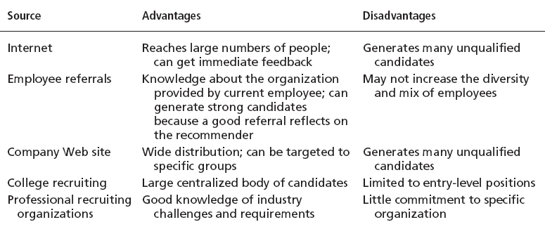
Exhibit 12–4 Major Sources of Potential Job Candidates

Slide 18
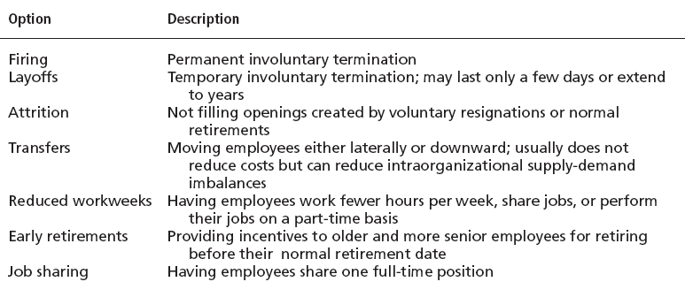
Exhibit 12–5 Decruitment Options

Slide 19
Selection
Selection Process
  The process of screening job applicants to ensure that the most appropriate candidates are hired.
What is Selection?
  An exercise in predicting which applicants, if hired, will be (or will not be) successful in performing well on the criteria the organization uses to evaluate performance.
  Selection errors:
    Reject errors for potentially successful applicants
    Accept errors for ultimately poor performers

Slide 20
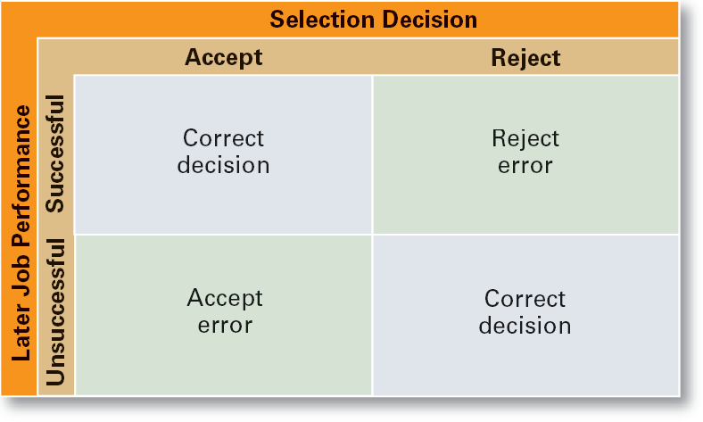
Exhibit 12–6 Selection Decision Outcomes

Slide 21
Validity and Reliability
Validity (of Prediction)
  A proven relationship between the selection device used and some relevant criterion for successful performance in an organization.
    High tests scores equate to high job performance; low scores to poor performance.
Reliability (of Prediction)
  The degree of consistency with which a selection device measures the same thing.
    Individual test scores obtained with a selection device are consistent over multiple testing instances.

Slide 22

Exhibit 12–7 Selection Devices
Application Forms
Written Tests
Performance Simulations
Interviews
Background Investigations
Physical examinations

Slide 23
Written Tests
Types of Tests
  Intelligence: how smart are you?
  Aptitude: can you learn to do it?
  Attitude: how do you feel about it?
  Ability: can you do it now?
  Interest: do you want to do it?
Legal Challenges to Tests
  Lack of job-relatedness of test items or interview questions to job requirements
  Discrimination in equal employment opportunity against members of protected classes

Slide 24
Performance Simulation Tests
Testing an applicant’s ability to perform actual job behaviors, use required skills, and demonstrate specific knowledge of the job.
  Work sampling
    Requiring applicants to actually perform a task or set of tasks that are central to successful job performance.
  Assessment centers
    Dedicated facilities in which job candidates undergo a series of performance simulation tests to evaluate their managerial potential.

Slide 25
Other Selection Approaches
Interviews
  Although used almost universally, managers need to approach interviews carefully.
Background Investigations
  Verification of application data
  Reference checks:
    Lack validity because self-selection of references ensures only positive outcomes.
Physical Examinations
  Useful for physical requirements and for insurance purposes related to pre-existing conditions.

Slide 26
Exhibit 12–8 Suggestions for Interviewing
Structure a fixed set of questions for all applicants.
Have detailed information about the job for which applicants are interviewing.
Minimize any prior knowledge of applicants’ background, experience, interests, test scores, or other characteristics.
Ask behavioral questions that require applicants to give detailed accounts of actual job behaviors.
Use a standardized evaluation form.
Take notes during the interview.
Avoid short interviews that encourage premature decision making.
Source: Based on D.A. DeCenzo and S.P. Robbins, Human Resource Management, 7th ed. (New York Wiley: 2002, p. 200)

Slide 27
Exhibit 12–9 Examples of “Can’t Ask and Can Ask” Interview Questions for Managers*
Can’t Ask
  What’s your birth date? or How old are you?
  What’s your marital status? or Do you plan to have a family?
  What’s your native language?
  Have you ever been arrested?
Can Ask
  Are you over 18?
  Would you relocate?
  Are you authorized to work in the United States?
  Have you ever been convicted of [fill in the blank]?—The crime must be reasonably related to the performance of the job.
* Note: Managers should be aware that there are numerous other “can and can’t ask” questions. Be sure to always check with your HR department for specific guidance.

Slide 28
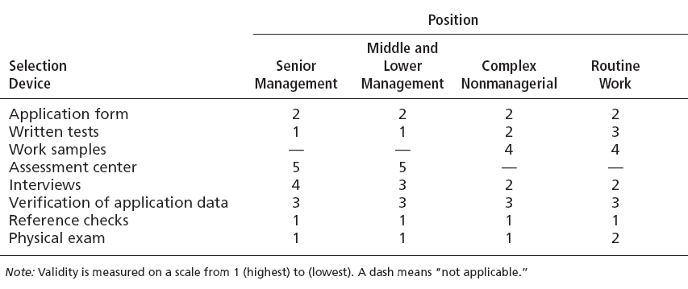
Exhibit 12–10 Quality of Selection Devices as Predictors

Slide 29
Other Selection Approaches (cont’d)
Realistic Job Preview (RJP)
  The process of relating to an applicant both the positive and the negative aspects of the job.
    Encourages mismatched applicants to withdraw.
    Aligns successful applicants’ expectations with actual job conditions; reducing turnover.

Slide 30
Orientation
Transitioning a new employee into the organization.
  Work-unit orientation
    Familiarizes new employee with work-unit goals
    Clarifies how his or her job contributes to unit goals
    Introduces he or she to his or her coworkers
  Organization orientation
    Informs new employee about the organization’s objectives, history, philosophy, procedures, and rules.
    Includes a tour of the entire facility

Slide 31
Exhibit 12–11 Types of Training
Type | Includes
General | Communication skills, computer systems application and programming, customer service, executive development, management skills and development, personal growth, sales, supervisory skills, and technological skills and knowledge
Specific | Basic life/work skills, creativity, customer education, diversity/cultural awareness, remedial writing, managing change, leadership, product knowledge, public speaking/presentation skills, safety, ethics, sexual harassment, team building, wellness, and others
Source: Based on “2005 Industry Report—Types of Training,” Training, December 2005, p. 22.

Slide 32
Exhibit 12–12 Employee Training Methods
Traditional
Training Methods
  On-the-job
  Job rotation
  Mentoring and coaching
  Experiential exercises
  Workbooks/manuals
  Classroom lectures
Technology-Based Training Methods
  CD-ROM/DVD/videotapes/ audiotapes
  Videoconferencing/ teleconferencing/
  satellite TV
  E-learning

Slide 33

Employee Performance Management
Performance Management System
  A process of establishing performance standards and appraising employee performance in order to arrive at objective HR decisions and to provide documentation in support of those decisions.

Slide 34
Exhibit 12–13 Advantages and Disadvantages of Performance Appraisal Methods
Method | Advantage | Disadvantage
Written essays | Simple to use | More a measure of evaluator’s writing ability than of employee’s actual performance
Critical incidents | Rich examples; behaviorally based | Time-consuming; lack quantification
Graphic rating scales | Provide quantitative data; less time-consuming than others | Do not provide depth of job behavior assessed
BARS | Focus on specific and measurable job behaviors | Time-consuming; difficult to develop
Multiperson comparisons | Compares employees with one another | Unwieldy with large number of employees; legal concerns
MBO | Focuses on end goals; results oriented | Time-consuming
360-degree appraisals | Thorough | Time-consuming

Slide 35
Compensation and Benefits
Benefits of a Fair, Effective, and Appropriate Compensation System
  Helps attract and retain high-performance employees
  Impacts on the strategic performance of the firm
Types of Compensation
  Base wage or salary
  Wage and salary add-ons
  Incentive payments
  Skill-based pay
  Variable pay

Slide 36
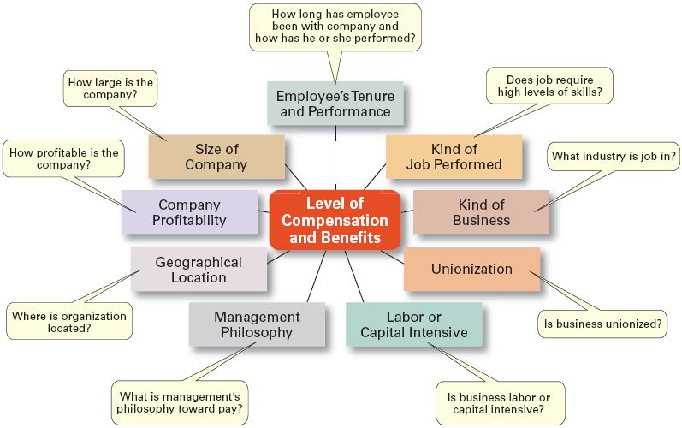
Exhibit 12–14 Factors That Influence Compensation and Benefits
Sources: Based on R.I. Henderson, Compensation Management, 6th ed. (Upper Saddle River, NJ: Prentice Hall, 1994), pp. 3–24; and A. Murray, “Mom, Apple Pie, and Small Business,” Wall Street Journal, August 15, 1994, p. A1

Slide 37
Career Development
Career Defined
  The sequence of positions held by a person during his or her lifetime.
  The Way It Was
    Career Development
      Provided for information, assessment, and training
      Helped attract and retain highly talented people
    Now
      Individuals—not the organization—are responsible for designing, guiding, and developing their own careers.
  Boundaryless Career
    A career in which individuals, not organizations, define career progression and organizational loyalty

Slide 38
Exhibit 12–15 What College Graduates Want From Jobs
Top Factors for U.S. Students
  Work–life balance
  Annual base salary
  Job stability and security
  Recognition for a job done well
  Increasingly challenging tasks
  Rotational programs
Top Factors for U.K. Students
  International career opportunities
  Flexible working hours
  Variety of assignments
  Paid overtime
Sources: Based on S. Shellenbarger, “Avoiding the Next Enron: Today’s Crop of Soon-to-Be Grads Seeks Job Security,” Wall Street Journal Online, February 16, 2006; “MBAs Eye Financial Services and Management Consulting,” HRMarketer.com, June 7, 2005; and J. Boone, “Students Set Tighter Terms for Work,” FinancialTimes.com, May 21, 2005.

Slide 39
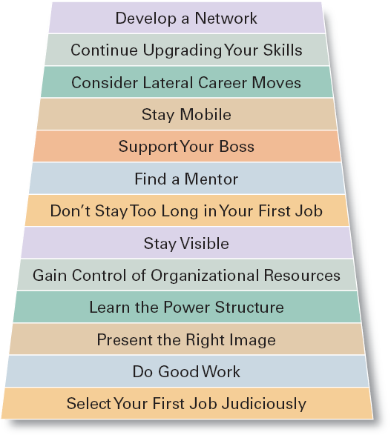
Exhibit 12–16
Some Suggestions for a Successful Management Career

Slide 40
Current Issues in HRM
Managing Downsizing
  The planned elimination of jobs in an organization
    Provide open and honest communication.
    Provide assistance to employees being downsized.
    Reassure and counseling to surviving employees.
Managing Work Force Diversity
  Widen the recruitment net for diversity
  Ensure selection without discrimination
  Provide orientation and training that is effective

Slide 41
Current Issues in HRM (cont’d)
Sexual Harassment
  An unwanted activity of a sexual nature that affects an individual’s employment.
    Unwanted sexual advances, requests for sexual favors, and other verbal or physical conduct of a sexual nature when submission or rejection of this conduct explicitly or implicitly affects an individual’s employment.
  An offensive or hostile environment
    An environment in which a person is affected by elements of a sexual nature.
Workplace Romances
  Potential liability for harassment

Slide 42
Current Issues in HRM (cont’d)
Work-Life Balance
  Employees have personal lives that they don’t leave behind when they come to work.
  Organizations have become more attuned to their employees by offering family-friendly benefits:
    On-site child care
    Summer day camps
    Flextime
    Job sharing
    Leave for personal matters
    Flexible job hours

Slide 43
Current Issues in HRM (cont’d)
Controlling HR Costs
  Employee health-care
    Encouraging healthy lifestyles
      Financial incentives
      Wellness programs
      Charging employees with poor health habits more for benefits
  Employee pension plans
    Reducing pension benefits
    No longer providing pension plans

Slide 44
Terms to Know
high-performance work practices
human resource management process
labor union
affirmative action
human resource planning
job analysis
job description
job specification
recruitment
decruitment
selection
validity
reliability
work sampling
assessment centers
realistic job preview (RJP)
orientation
performance management system
written essay
critical incidents
graphic rating scales

Slide 45
Terms to Know (cont’d)
behaviorally anchored rating scales (BARS)
multiperson comparisons
360 degree feedback
skill-based pay
variable pay
career
downsizing
sexual harassment
family-friendly benefits

